Slide 1
Bray Team Week 12 Update
Avery Haynes, Locke Lehmann, Travis Carlson, Cody Sims, Zachary Walker, Michael Hager
4/15/2024

Slide 2
Weekly Deliverables
Tasks | Lead | Percentage Done | Notes
Begin potentiometer validation testing | Avery/Michael | 50% | Do more test runs.
Strain Gauge Measurement | Zack/ Michael | 75% | Attached boards and jumper wires, get readings
Test motor system | Cody/Travis | 90% | Got readings, working on equation for torque.
Hall effect sensor Test | Locke/Travis | 50% | Get data readings.

Slide 3
Strain gauges Update
Broke when installing the stop bolts in the actuator
Have reservation tomorrow to epoxy new sensors into the stop bolts
Instead of soldering the wires will use alligator clips to prevent winding
Not too much of a set back, as we already were planning to fix the first stop bolt that broke.
Will start reading data as soon as Wednesday

Slide 4
Hall Effect sensor Issues
Currently troubleshooting as the Pi is not detecting the sensor.
Cannot be found in the pi directory
Have code written and ready to test once the pi and the sensor integrate

Slide 5
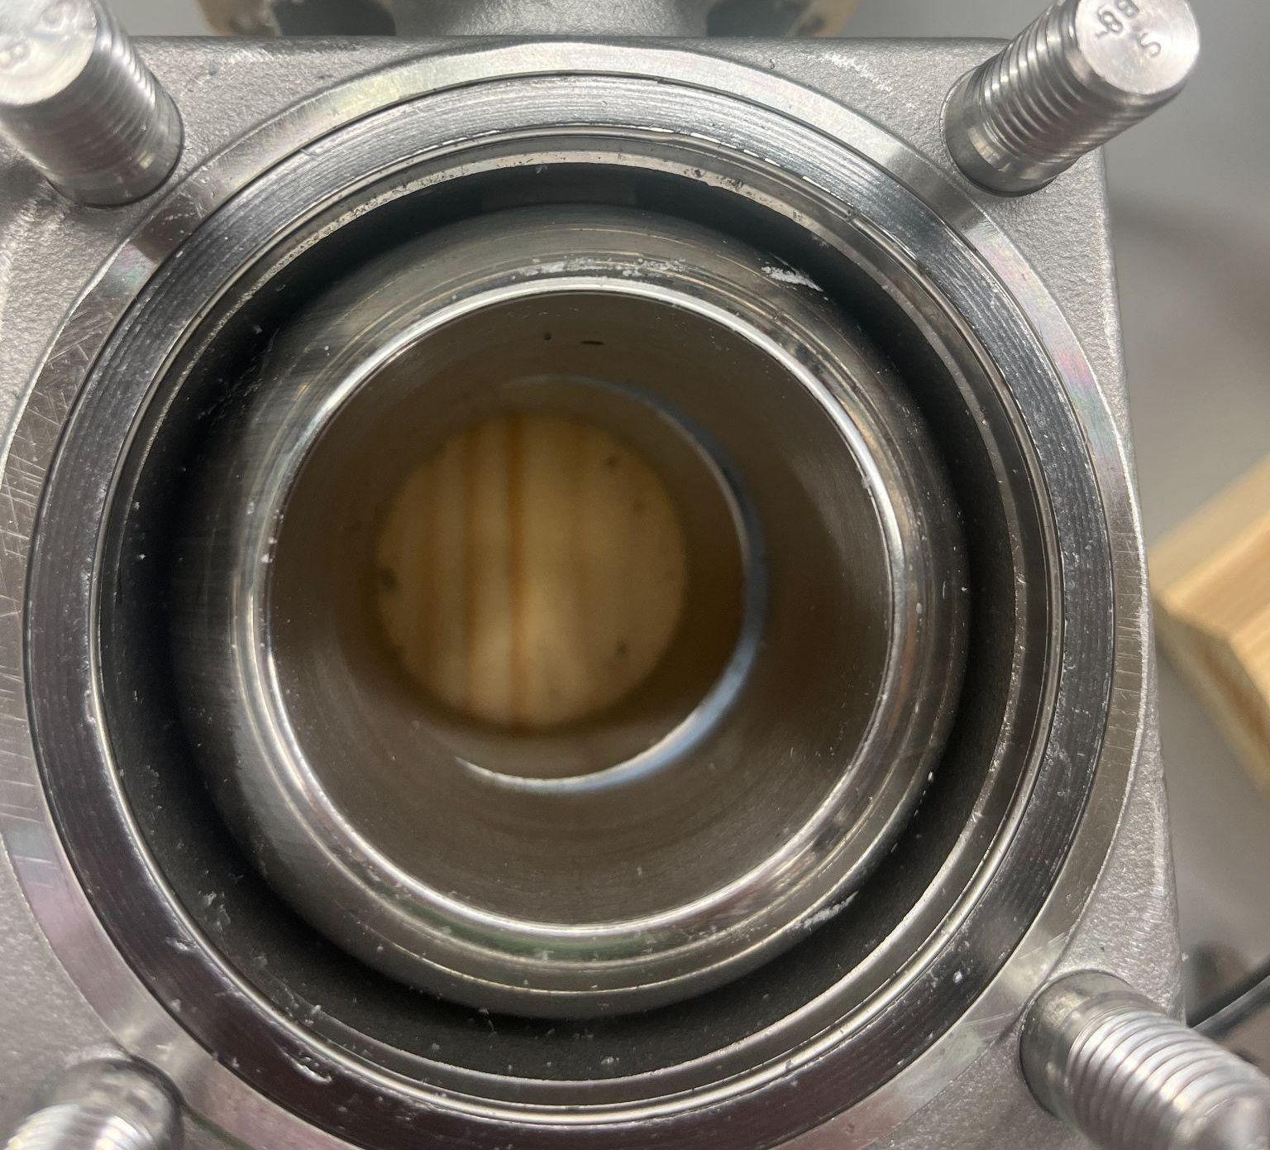
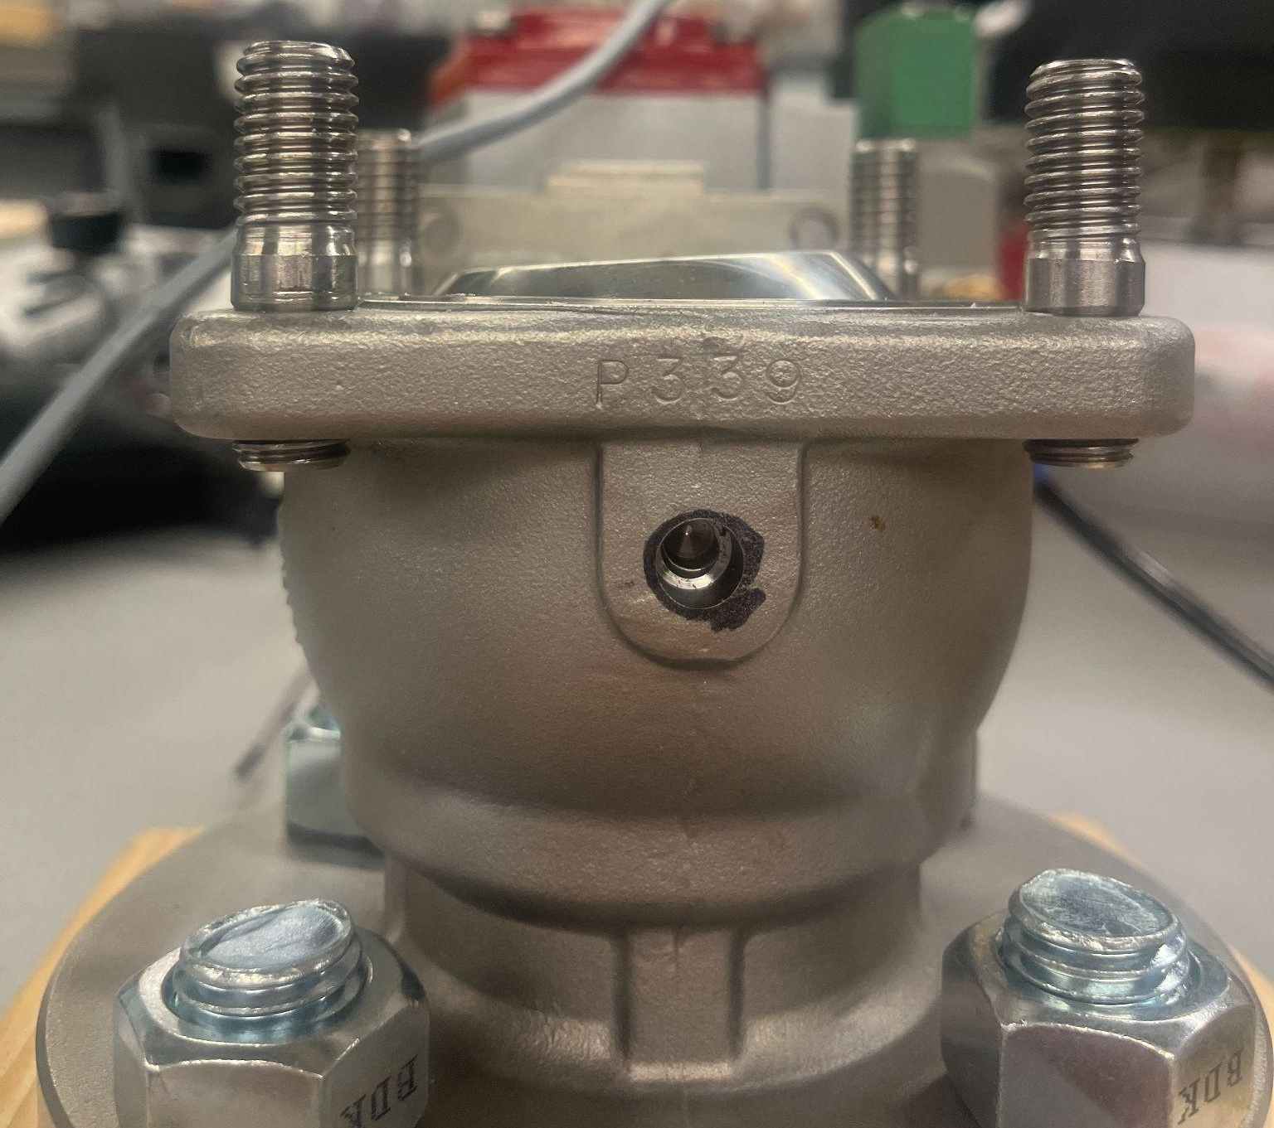
Potentiometer Reading explained
Potentiometer read 86.4 consistently.
Reading should be 90 but when examining the ball you can see a slight slant.
Use the positioner to set the exact position to get accuracy

Slide 6
Final Presentation
Thursday, April 25th
4-5 PM (room reserved from 3:30-5:30 PM)
ZACH 250 (12 person capacity)
Sent parking passes to Bray engineers

Slide 7
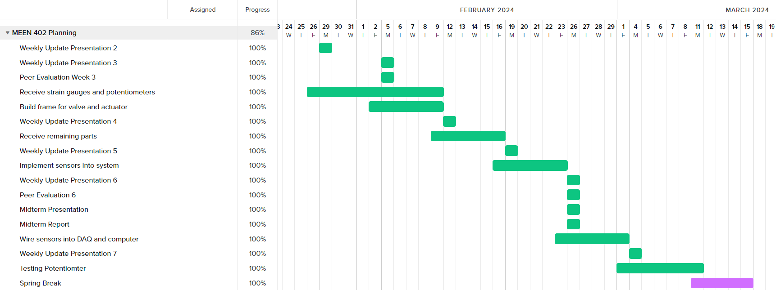
Gantt Chart

Slide 8
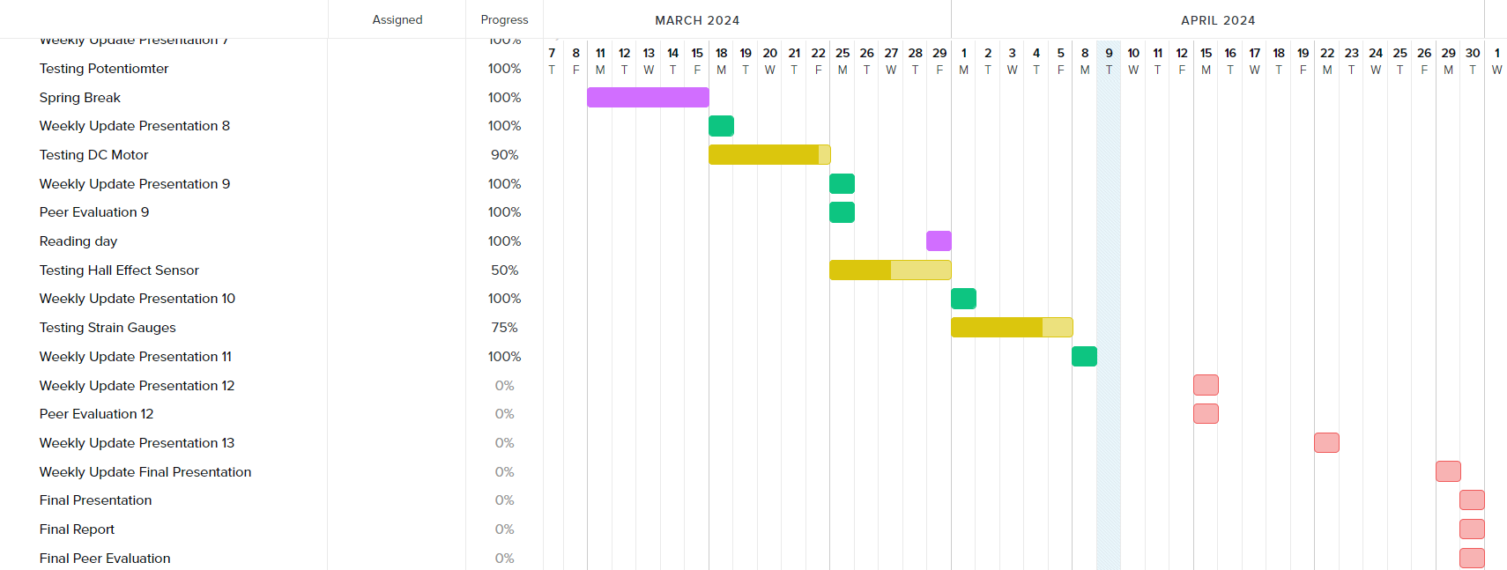
Gantt Chart

Slide 9
Next Week’s Deliverables
Tasks | Lead | Percentage Done | Notes
Begin potentiometer validation testing | Avery/Michael | 50% | Do more test runs.
Strain Gauge Measurement | Zack/ Michael | 75% | Attached boards and jumper wires, get readings
Test motor system | Cody/Travis | 90% | Got readings, working on equation for torque.
Hall effect sensor Test | Locke/Travis | 50% | Get data readings.

